Slide 1
project
MINING SECURITY SYSTEM
ID-190040651
NAME-P.RAJESH

Slide 2
Index:
1) Introduction.
2)Abstract.
3)Components.
4)Expected Output.
5)Code
6)Output in proteus.
7)output

Slide 3
INTRODUCTION
The project is about the Security System in Mining and how to solve some minor problems.
The main Problems in Mining are the
1)Earthquake.
2)Heat.
3)Gas Leakage.

Slide 4
ABSTRACT
The project is about the mining security system. The Project Contain Three Different types of Sensors that are related to the mining security.
The project is done in the Proteus Software.
The Sensor Sense the abnormal Behavior from the environment and send the data to the lcd display and alert the workers using the buzzer.
The Sensor used in this Project are the Vibration Sensor, Temperature Sensor, and the Gas Sensor.
If minor Gas leak occurs it automatically remove the Gas from the area using the motor.
If the temperature increase it can be cool down by the motor.

Slide 5
COMPONENTS
The components used in this project are:
Vibration sensor
Gas sensor
Temperature Sensor
Arduino Uno
LCD Display
L293D
DC MOTORS
BUZZER
LED

Slide 6
VIBRATION SENSOR
A vibration sensor is a device that measures the amount and frequency of Vibration in a given system, machine, or piece of equipment.
In this vibration sensor is used for Detecting Vibration under the earth.
Contain 3 pins:
1)VCC
2)GND
3)OUTPUT

Slide 7
GAS SENSOR
A Gas Detector is a device that detects the presence of Gases in an area, often as part of a safety system.
Gases are:
1. Acetylene
2. Ammonia
3. Butane
4. Hydrogen
5. Methane
6. Propane

Slide 8
TEMPERATURE SENSOR
The sensor used for temperature reading is LM35
It read the data in analog and gives in 10mV/°C. so, the output must be divided by 10 so the it can get exact value.
The sensor contains 3 pins :
1)Output
2)VCC
3)GND

Slide 9
EXPECTED OUTPUT
The Sensors observe the environment behavior and send the data to the Arduino Uno.
The Arduino Uno Observe the data and see any abnormal behavior occurs.
If any problem occurs the Arduino Uno will react according to the problem.
If the Problem is major and Risky the Arduino uno will alert the Workers using the Display.
If gas detection is more then the given value then the l293d get activated and start the motors to rotate.
The led is used for alert the workers as with the green it 9is clear and for the red it is danger.
Buzzer is turn on when the any of the above is sensed for danger and alert the workers.

Slide 10
code
void TEMP()
{
float temp_adc,temp_val;
temp_adc = analogRead(temp_Read);
temp_val= (temp_adc*4.88);
temp_val= (temp_val/10);
if(temp_val>50.0)
{
lcd.clear();
lcd.print("temp=");
lcd.setCursor(5,0);
lcd.print(temp_val);
lcd.setCursor(11,0);
lcd.print("deg C");
lcd.setCursor(0,1);
lcd.print("FIRE");
#include<LiquidCrystal.h>
const int temp_Read = A1;
const int vib_pin = 6;
LiquidCrystal lcd(12, 11, 5, 4, 3, 2);
const int gas_sensor = 8;---
const int buzzer = 7;
const int vibration_pin =A5;
const int vib_val = 200;

Slide 11
Serial.println(temp_val);
Serial.println("FIRE");
tone(buzzer,1000);
delay(1000);
noTone(buzzer);
}
else{
lcd.clear();
lcd.print("temp=");
lcd.setCursor(5,0);
lcd.print(temp_val);
lcd.setCursor(11,0);
lcd.print("deg C");
lcd.setCursor(0,1);
lcd.print("NO FIRE");
Serial.println(temp_val);
Serial.println("NO FIRE");
delay(1000);
}
}
void VIBRATION()
{
int val,vibration_output;
val=digitalRead(vib_pin);
if(val==HIGH)
{
lcd.clear();
lcd.setCursor(0,0);
lcd.print("Earthquake");
Serial.println("earthquake");

Slide 12
Serial.println(val);
tone(buzzer,1000);
delay(1000);
noTone(buzzer);
}
else
{
lcd.clear();
lcd.setCursor(0,0);
lcd.print("no earthquake");
Serial.println("No earthquake");
Serial.println(val);
delay(1000);
}
}
void GAS(){
int gas_reading = digitalRead(gas_sensor);
if(gas_reading == HIGH)
{
lcd.clear();
lcd.setCursor(0,0);
lcd.print("GAS");
Serial.println("GAS Detected");
Serial.println(gas_reading);
digitalWrite(10,HIGH);
digitalWrite(9,HIGH);
tone(buzzer,1000);
delay(1000);
noTone(buzzer);
}

Slide 13
else
{
lcd.clear();
lcd.setCursor(0,0);
lcd.print("NO GAS");
Serial.println("NO GAS Detected");
Serial.println(gas_reading);
digitalWrite(10,LOW);
digitalWrite(9,LOW);
delay(1000);
}
}
void setup(){
Serial.begin(9600);
lcd.begin(16,2);
pinMode(temp_Read,INPUT);
pinMode(vibration_pin,INPUT);
pinMode(gas_sensor,INPUT);
pinMode(vib_pin,INPUT);
pinMode(buzzer,OUTPUT);
Serial.print("hello");
pinMode(10,OUTPUT);
pinMode(9,OUTPUT);
}
void loop(){
TEMP();
VIBRATION();
GAS();
delay(1000);
}

Slide 14
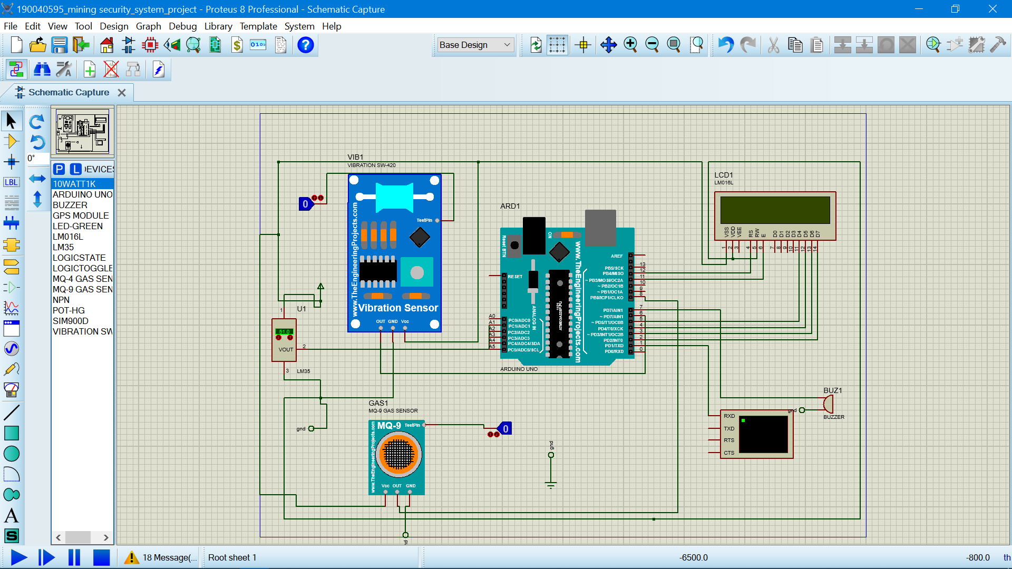
proteus

Slide 15
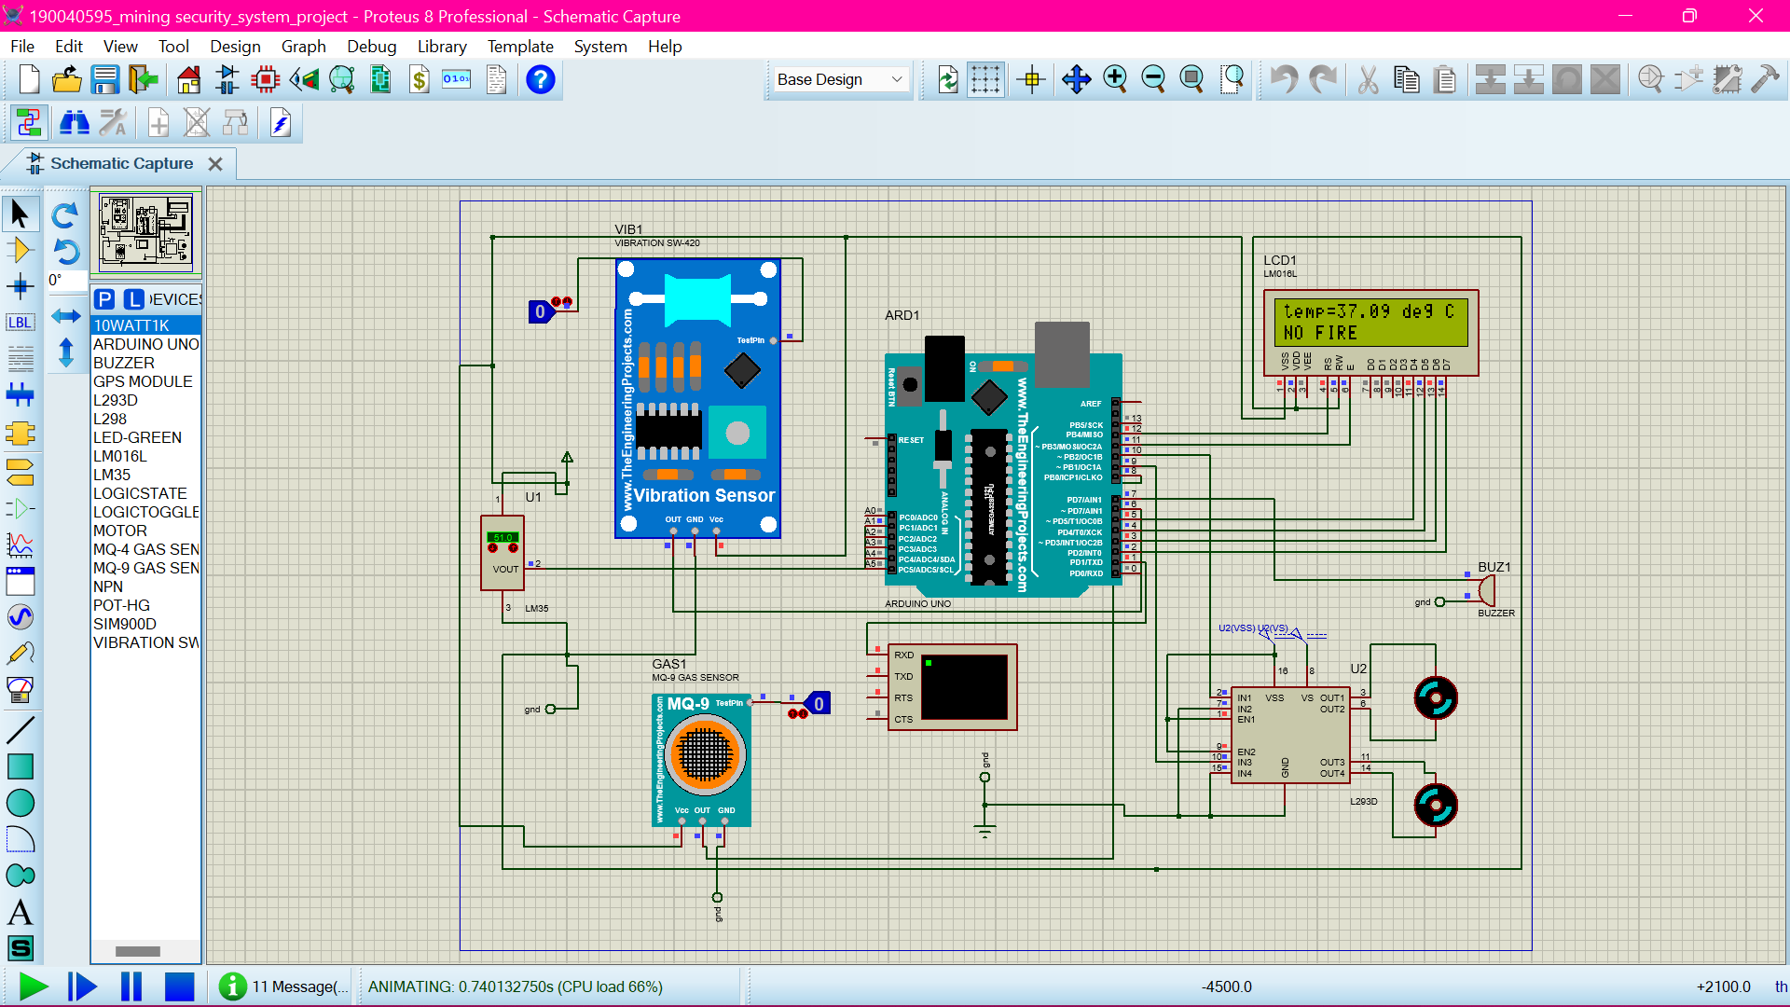
Output in proteus

Slide 16
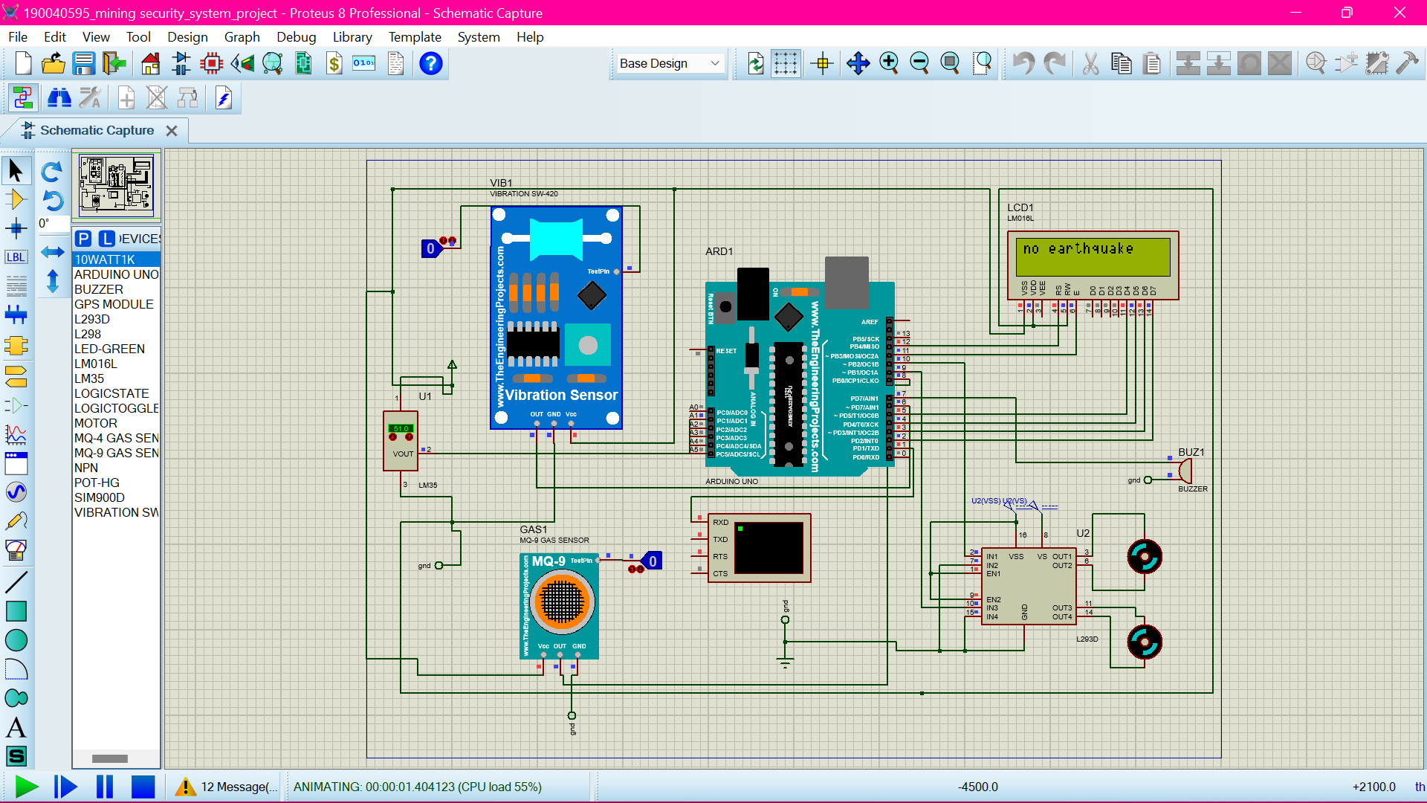
Output in proteus

Slide 17

Output in proteus

Slide 18

Output in proteus

Slide 19
Output in proteus

Slide 20
Output in proteus

Slide 21
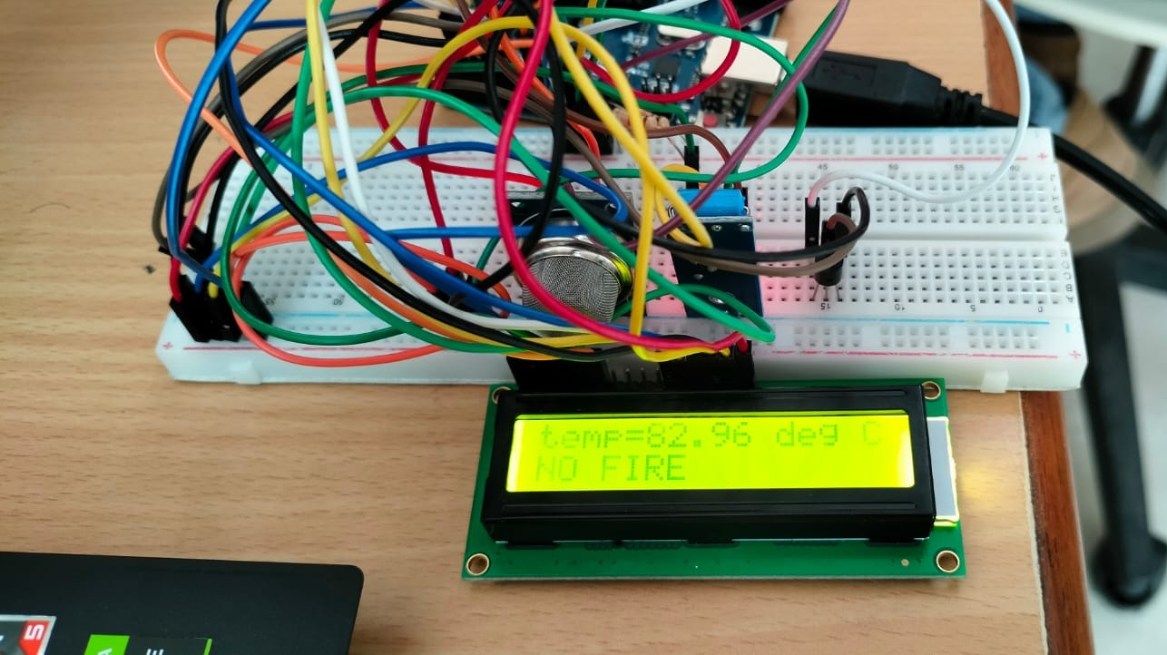
OUTPUTS
Fire Indication using Temperature Sensor.

Slide 22
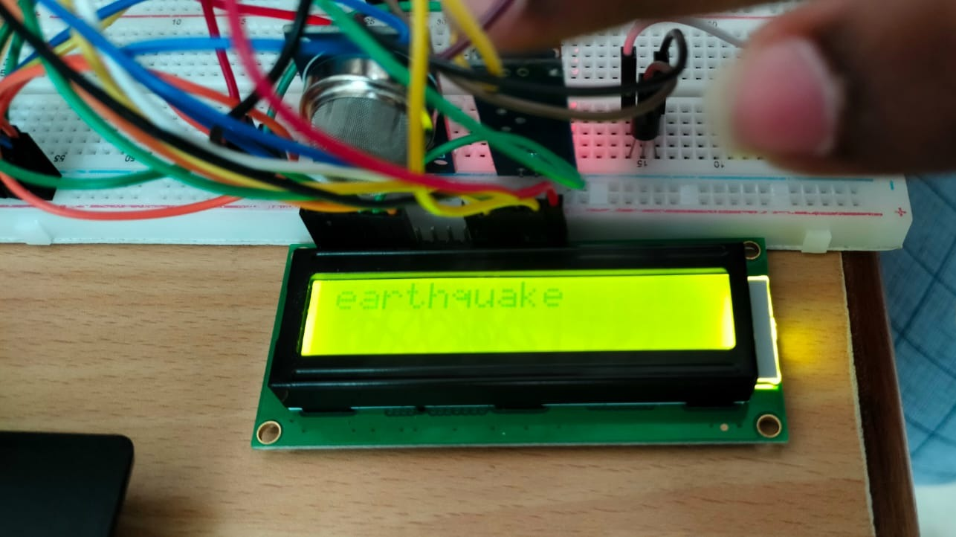
OUTPUTS
Earthquake detection using Vibration sensor

Slide 23
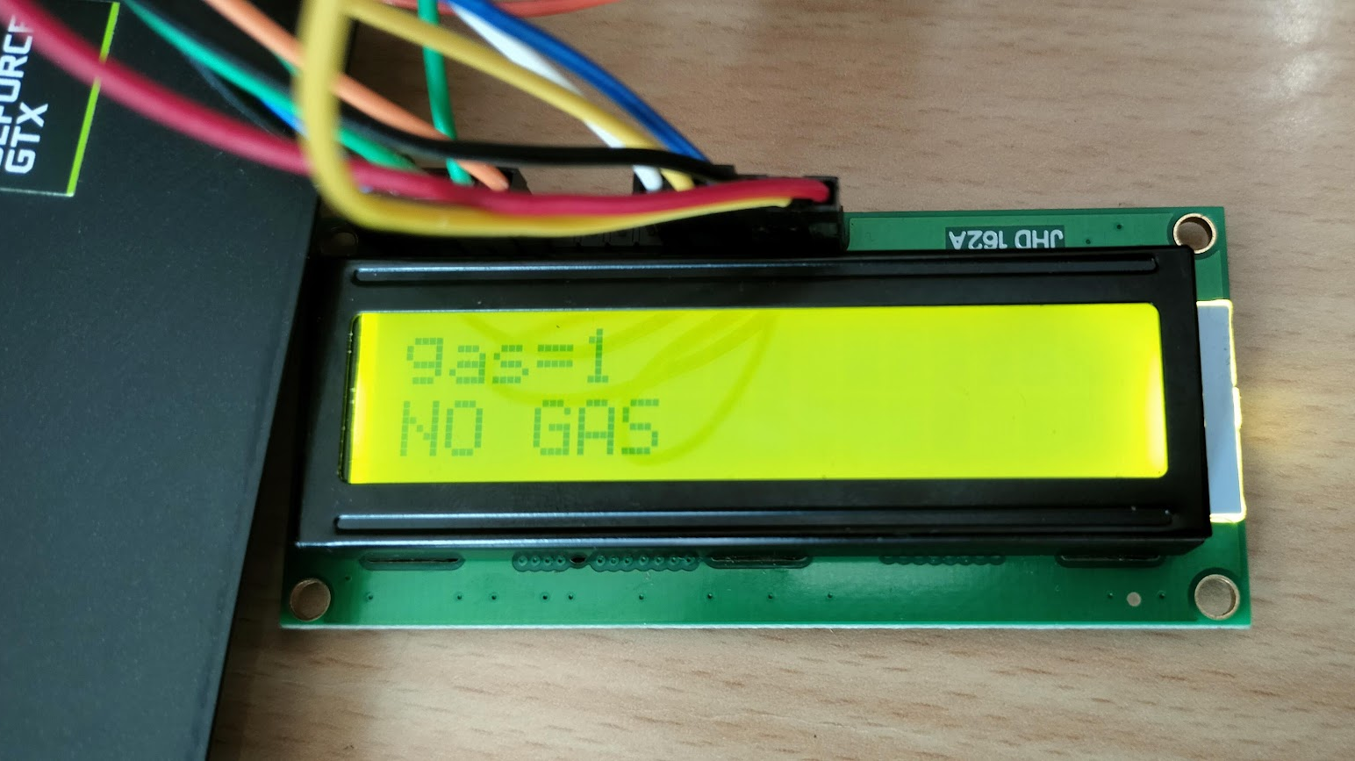
OUTPUTS
Gas Detection using MQ-2 Sensor

Slide 24
Thank you

